Slide 1
Latch versus Register
Latch
stores data when
clock is low
Register
stores data when
clock rises
D
Q
D
Q
Clk
Clk
Clk
Clk
D
D
Q
Q

Slide 2
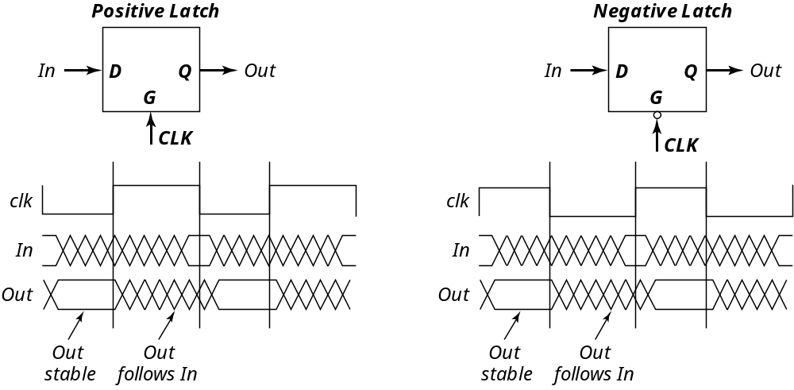
Latches

Slide 3
Latch-Based Design
N latch is transparent
when φ = 0
P latch is transparent
when φ = 1
φ
N
P
Logic
Latch
Latch
Logic

Slide 4
Timing Definitions
CLK
t
Register
t
su
t
hold
D
Q
D
DATA
CLK
STABLE
t
t
c
2
q
Q
DATA
STABLE
t

Slide 5
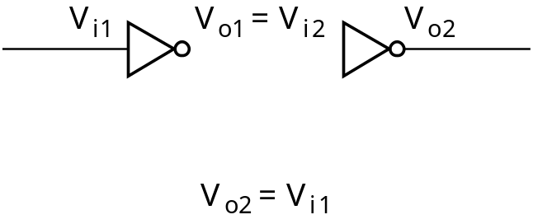
Positive Feedback: Bi-Stability
V
1
V_{i2}
1
o1
o
o
V
V
5
2
i
V
V
i
1
V
o
2
A
V
=
V
1
i
2
o
o
V
1
5
2
C
i
V
B
V
i
1
=
V
o
2

Slide 6
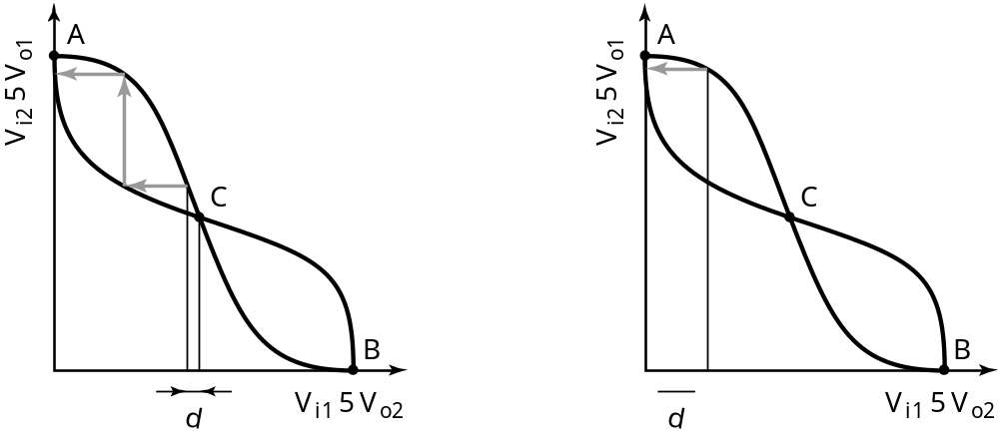
Meta-Stability
Gain should be larger than 1 in the transition region

Slide 7
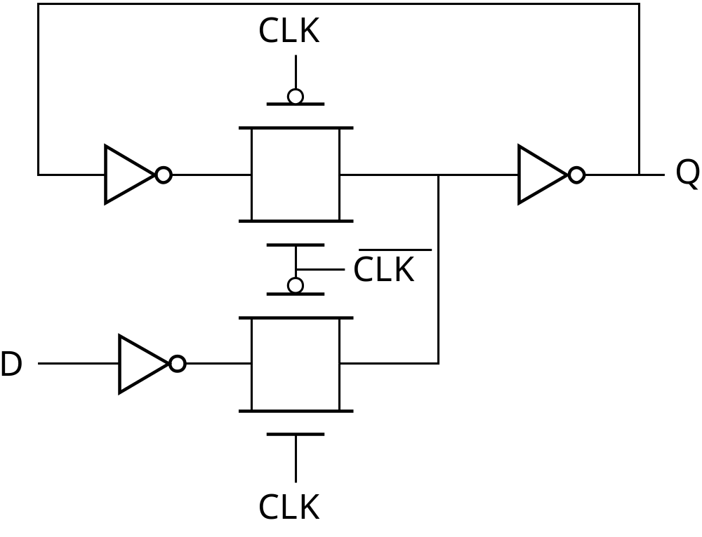
Writing into a Static Latch
Use the clock as a decoupling signal,
that distinguishes between the transparent and opaque states
CLK
D
D
CLK
Forcing the state
(can implement as NMOS-only)
Converting into a MUX

Slide 8


Mux-Based Latches
Negative latch
(transparent when CLK= 0)
Positive latch
(transparent when CLK= 1)
1
Q
0
Q
D
0
D
1
CLK
CLK

Slide 9
Mux-Based Latch

Slide 10
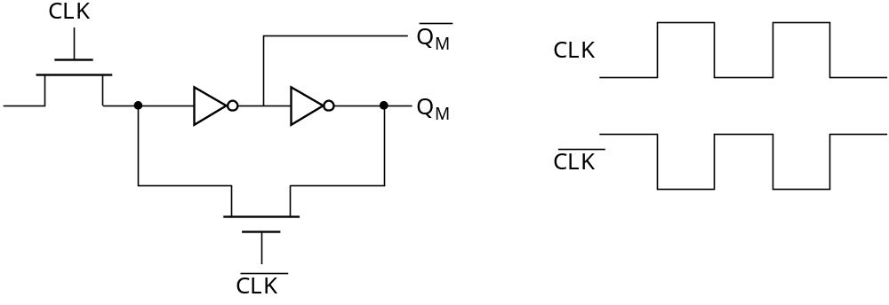
Mux-Based Latch
NMOS only
Non-overlapping clocks

Slide 11
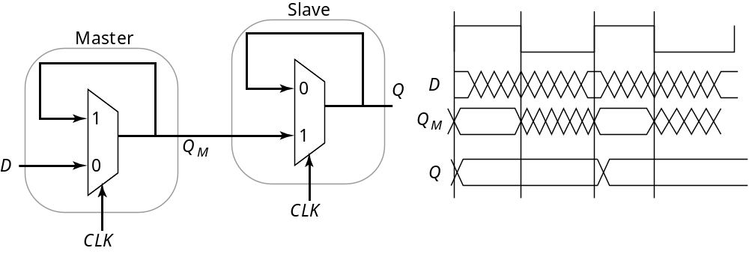
Master-Slave (Edge-Triggered) Register
Two opposite latches trigger on edge
Also called master-slave latch pair

Slide 12
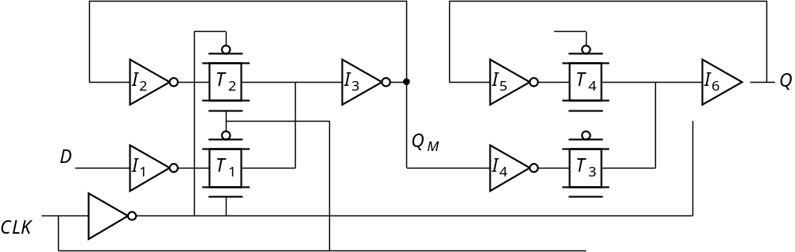
Master-Slave Register
Multiplexer-based latch pair

Slide 13
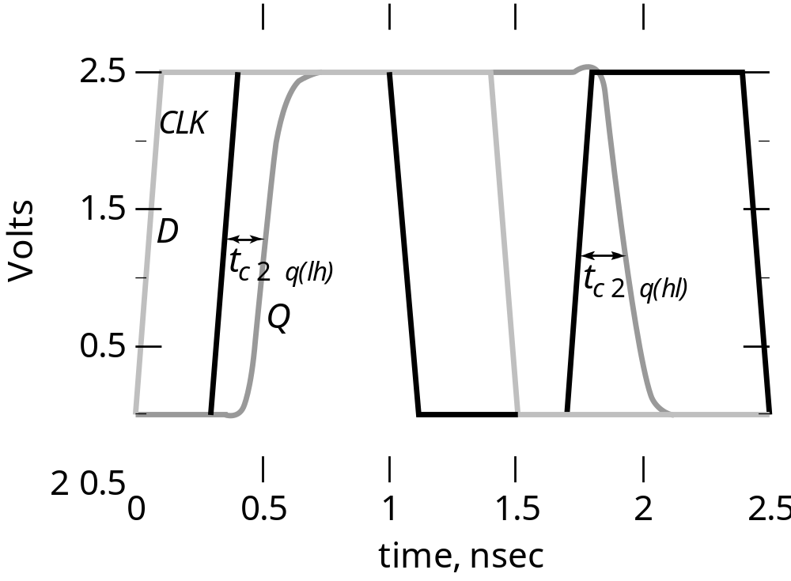
Clk-Q Delay

Slide 14
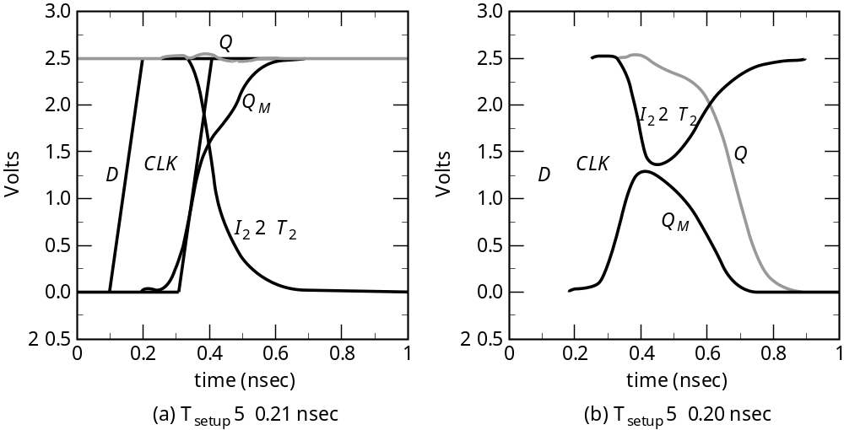
Setup Time

Slide 15
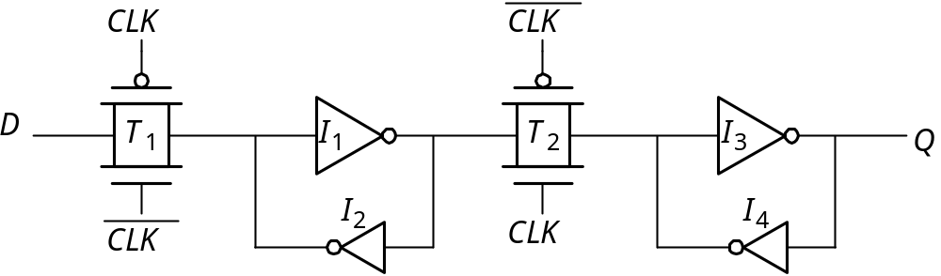
Reduced Clock Load
Master-Slave Register

Slide 16
Avoiding Clock Overlap
CLK
X
CLK
Q
D
A
B
CLK
CLK
(a) Schematic diagram
CLK
CLK
(b) Overlapping clock pairs

Slide 17
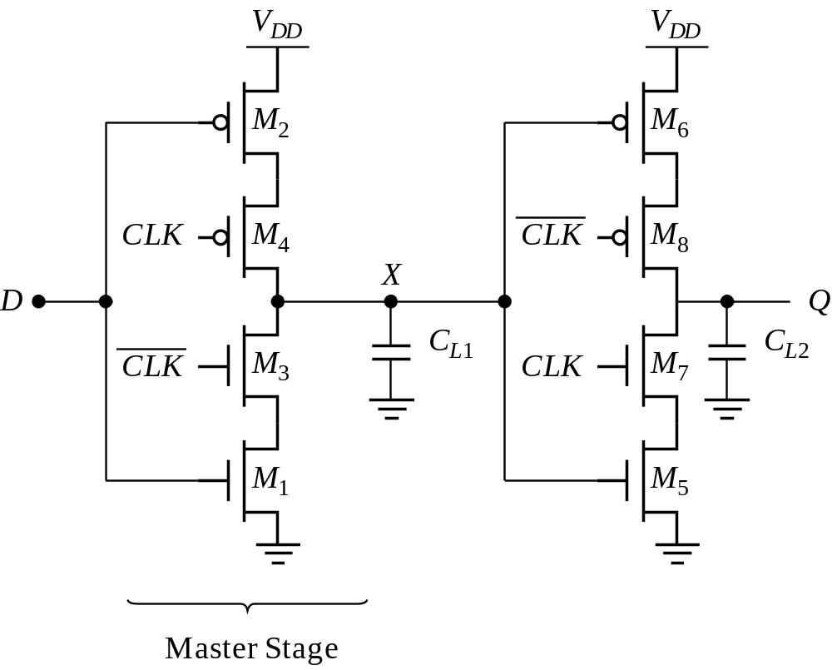
Other Latches/Registers: C²MOS
“Keepers” can be added to make circuit pseudo-static

Slide 18
Insensitive to Clock-Overlap
V
DD
V
DD
V
DD
V
DD
M
2
M
6
M
2
M
6
0
M
4
0
M
8
X
X
D
Q
D
Q
1
M
3
1
M
7
M
1
M
5
M
1
M
5
(a) (0-0) overlap
(b) (1-1) overlap

Slide 19
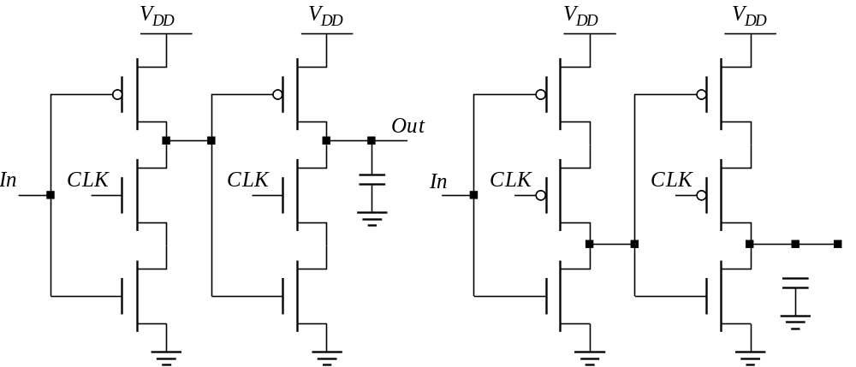
Other Latches/Registers: TSPC
Positive latch
(transparent when CLK= 1)
Negative latch
(transparent when CLK= 0)

Slide 20
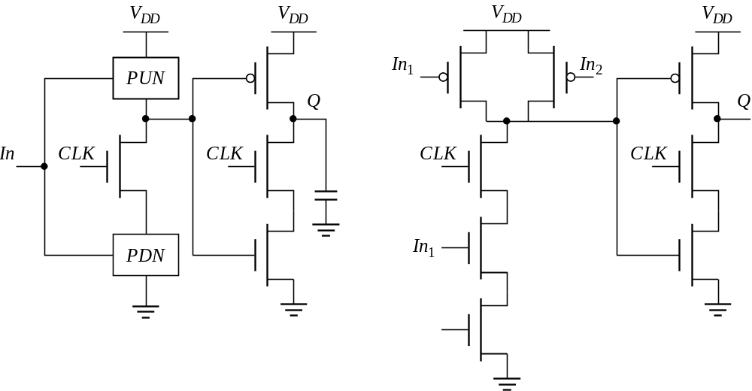
Including Logic in TSPC
Example: logic inside the latch
AND latch

Slide 21
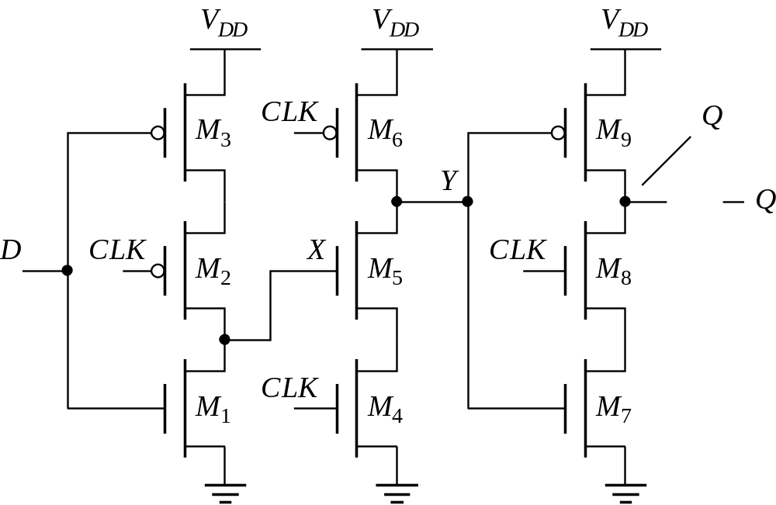
TSPC Register

Slide 22
Pulse-Triggered Latches
An Alternative Approach
Ways to design an edge-triggered sequential cell:
Master-Slave Latches
Pulse-Triggered Latch
L1
L2
L
Data
Data
D
Q
D
Q
D
Q
Clk
Clk
Clk
Clk
Clk

Slide 23
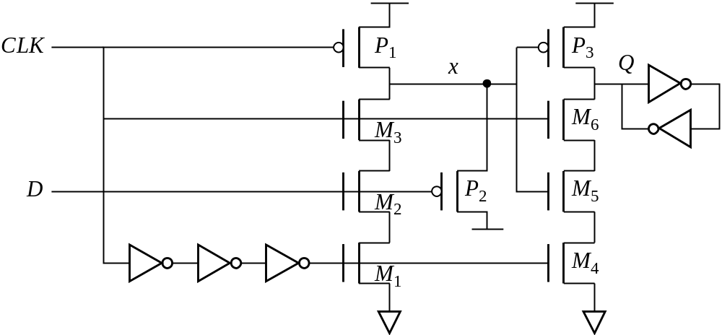
Pulsed Latches
Hybrid Latch – Flip-flop (HLFF), AMD K-6 and K-7 :

